Slide 1

Development of world LNG-fuelled shipping in 2014
All Russian forum “Current State and Prospects for Development of Russian Bunker Services Market”

Slide 2
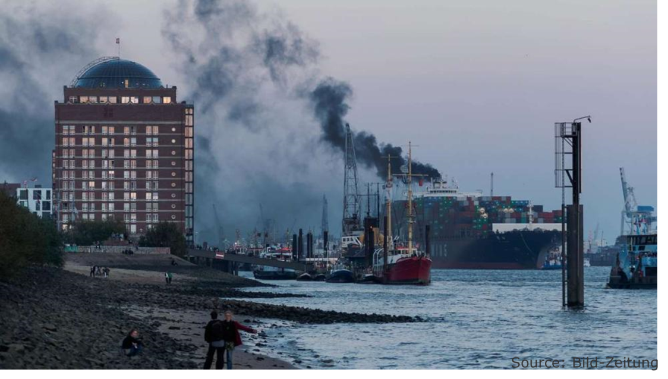
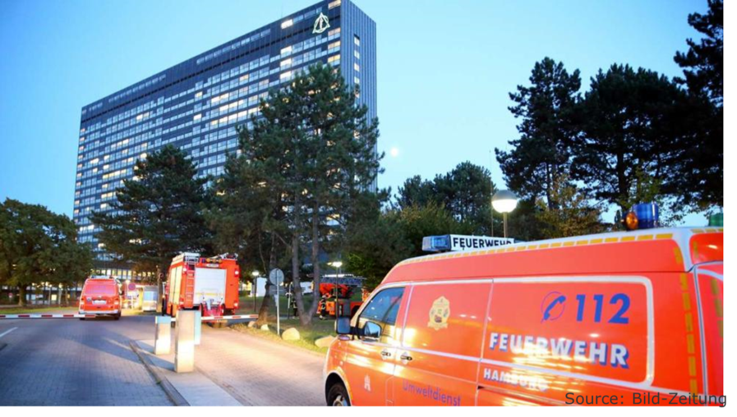
Hamburg, October 2014

Slide 3
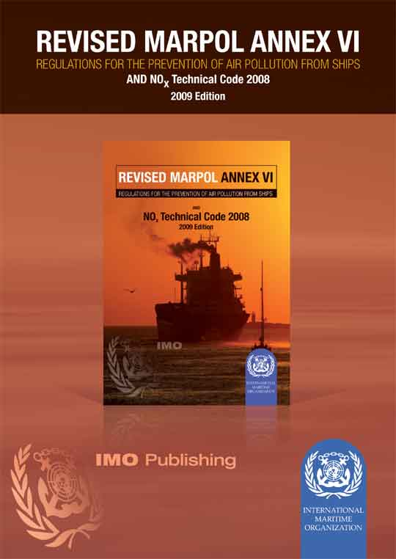
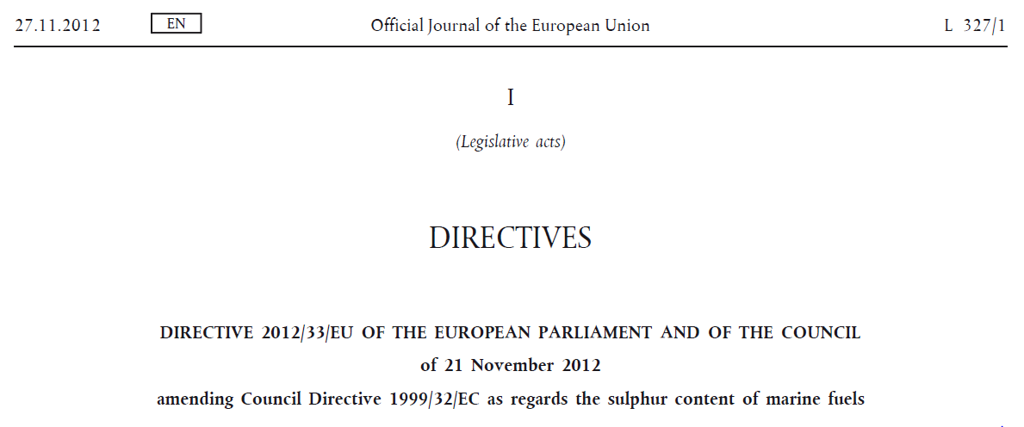
Shipping – main regulatory driver

Slide 4
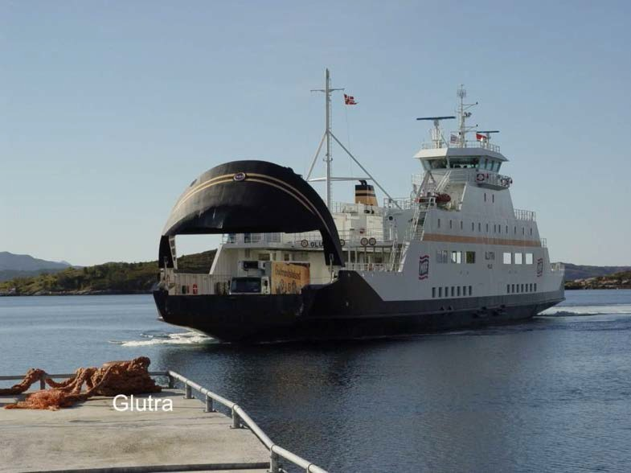
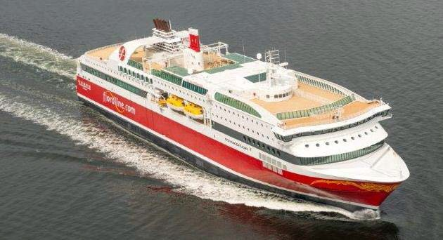
LNG fueled ships – past and today
2000
2013

Slide 5
183 confirmed LNG fuelled ships and projects
Updated 07.05.2015
Excluding LNG carriers and inland waterway vessels

Slide 6
LNG uptake by vessel segment
Updated 07.05.2015
Excluding LNG carriers and inland waterway vessels

Slide 7
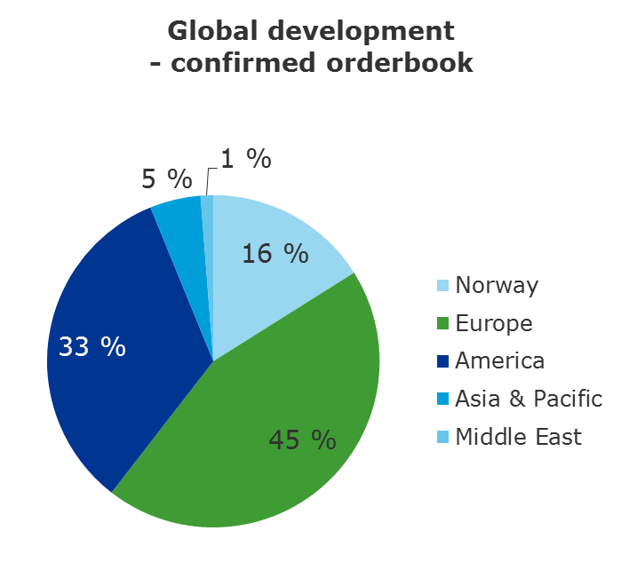
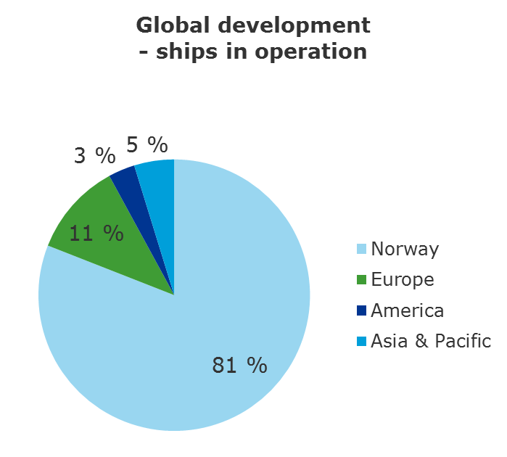
LNG fuelled ships spreading out from Norway

Slide 8
Engine concepts are in use for ship propulsion
Updated 07.05.2015
Excluding LNG carriers and inland waterway vessels
Notes:
“Gas” = pure gas engines (Rolls Royce and Mitsubishi)
“DF” = Dual Fuel (Wärtsilä and MAN). Some of the PSV DF ships actually have both DF and Diesel engines, but the DF engines typically produce >90% of the energy on board over a year.
“Gas + Diesel” = both pure gas and diesel engines are installed for ship propulsion, but the gas engines typically produce >90% of the energy on board over a year. Many “Gas” ships also have “take me home” diesel back-up solutions (Rolls Royce and Mitsubishi).
“Other” = is for now one gas turbine solution and two newbuilds where engine supplier is not confirmed.

Slide 9
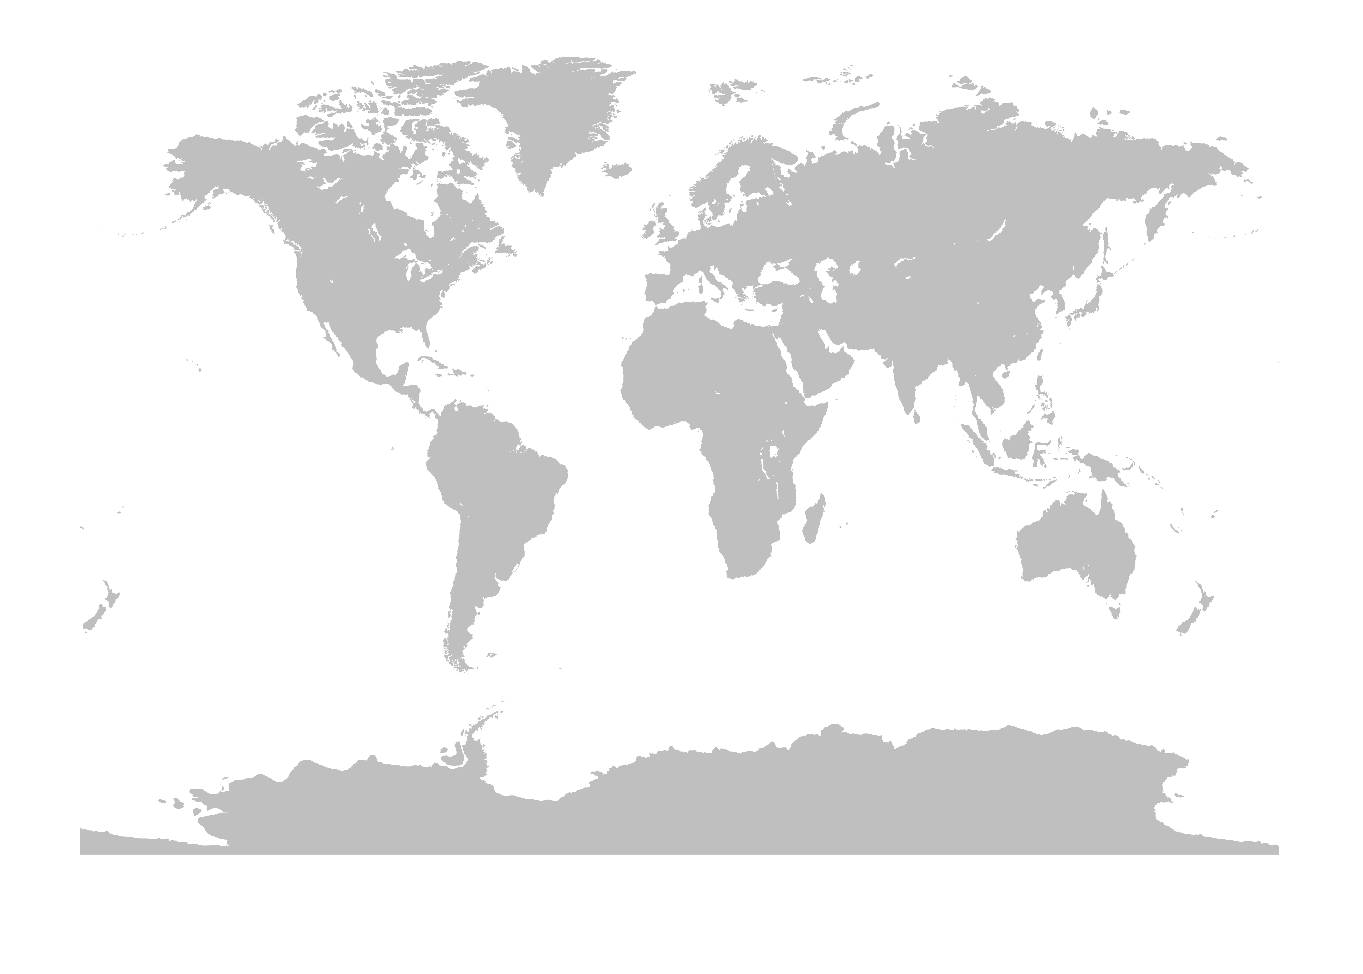
LNG Bunker-Infrastrukture, Globally
Duluth
Tadoussac
Vancouver
Seattle
Santander
Europe*
Tacoma
Sarnia
Ferrol
Barcelona
Turkish strait & Marmara Sea
Zhoushan
Mississippi river
New York
Algeciras
Valencia
Incheon
Louisiana
Cartagena
Dubai
Nanjing
Busan
Fourchon
Jacksonville
Wuhan
Shanghai
Pyeongtaek
Hambantota
Gaolan
Singapore
Buenos Aires
Existing
* See detailed map
Notes:
Main hubs where things are moving fast:
Scandinavia
Baltics
Northern Continental Europe
Gulf of Mexico and the Lakes
Canada
Middle East
Singapore

Slide 10
LNG Bunker-Infrastructure, Europe
Existing
Notes:
North: regulation driven
Center: regulation driven (Euro 6) and demand driven
Southwest: availability driven

Slide 11

The regulatory framework is developing fast
SGMF
DG Move
Rhine Ports
Antwerp, Rotterdam, Basel, Mannheim, Strasbourg
Antwerp, Rotter-dam
CCNR
IAPH
Bunker procedures
Rhine Regulations
Bunker procedures
Bunker guidelines
European Framework
Risk- related elements of Masterplan
Class Rules
ISO TS 18683
New ISO committees
IGF Code
Policy letters
Recommended Practices
ISO
IMO
USCG

Slide 12
Challenges Opportunities
Accident with LNG
Technology leadership
1st mover advantage
Sea – to – road
Societal wealth
Access to capital
Misfit of market mechanism
OPEX
Security of supply
Brand
More regulations
OPEX
alliances
Business model
CAPEX
Short-term financial expectation
Commercial niches

Slide 13
Jan.Tellkamp@dnvgl.com

